Slide 1



Software Engineering
203124253
Prof. Yoothika Patel, Assistant Professor
Computer Science & Engineering

Slide 2


Unit-4
Architectural Design

Slide 3
Architectural Design
Image source : Google

Slide 4
Architecture?
The architecture is not the operational software. Rather, it is a representation that enables a software engineer to:
(1) analyze the effectiveness of the design in meeting its stated requirements,
(2) consider architectural alternatives at a stage when making design changes is still relatively easy, and
(3) reduce the risks associated with the construction of the software.

Slide 5
Why is Architecture Important?
•Representations of software architecture are an enabler for communication between all parties (stakeholders) interested in the development of a computer-based system.
The architecture highlights early design decisions that will have a profound impact on all software engineering work that follows and, as important, on the ultimate success of the system as an operational entity.

Slide 6
Architectural Genres
Genre implies a specific category within the overall software domain.
Within each category, you encounter a number of subcategories.
For example, within the genre of buildings, you would encounter the following general styles: houses, condos, apartment buildings, office buildings, industrial building, warehouses, and so on.
Within each general style, more specific styles might apply. Each style would have a structure that can be described using a set of predictable patterns.

Slide 7
Architectural Styles
Each style describes a system category that encompasses:
A set of components (e.G., A database, computational modules) that perform a function required by a system,
A set of connectors that enable “communication, coordination and cooperation” among components,
(3) Constraints that define how components can be integrated to form the system, and
(4) Semantic models that enable a designer to understand the overall properties of a system by analyzing the known properties of its constituent parts.

Slide 8
Various Architectures
Data-centered architectures
Data flow architectures
Call and return architectures
Object-oriented architectures
Layered architectures

Slide 9
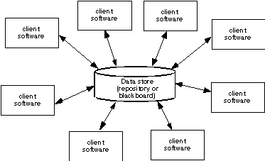
Data-Centered Architecture

Slide 10
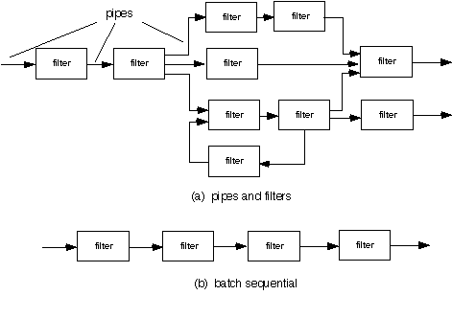
Data Flow Architecture

Slide 11
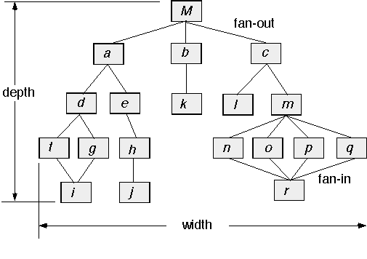
Call and Return Architecture

Slide 12
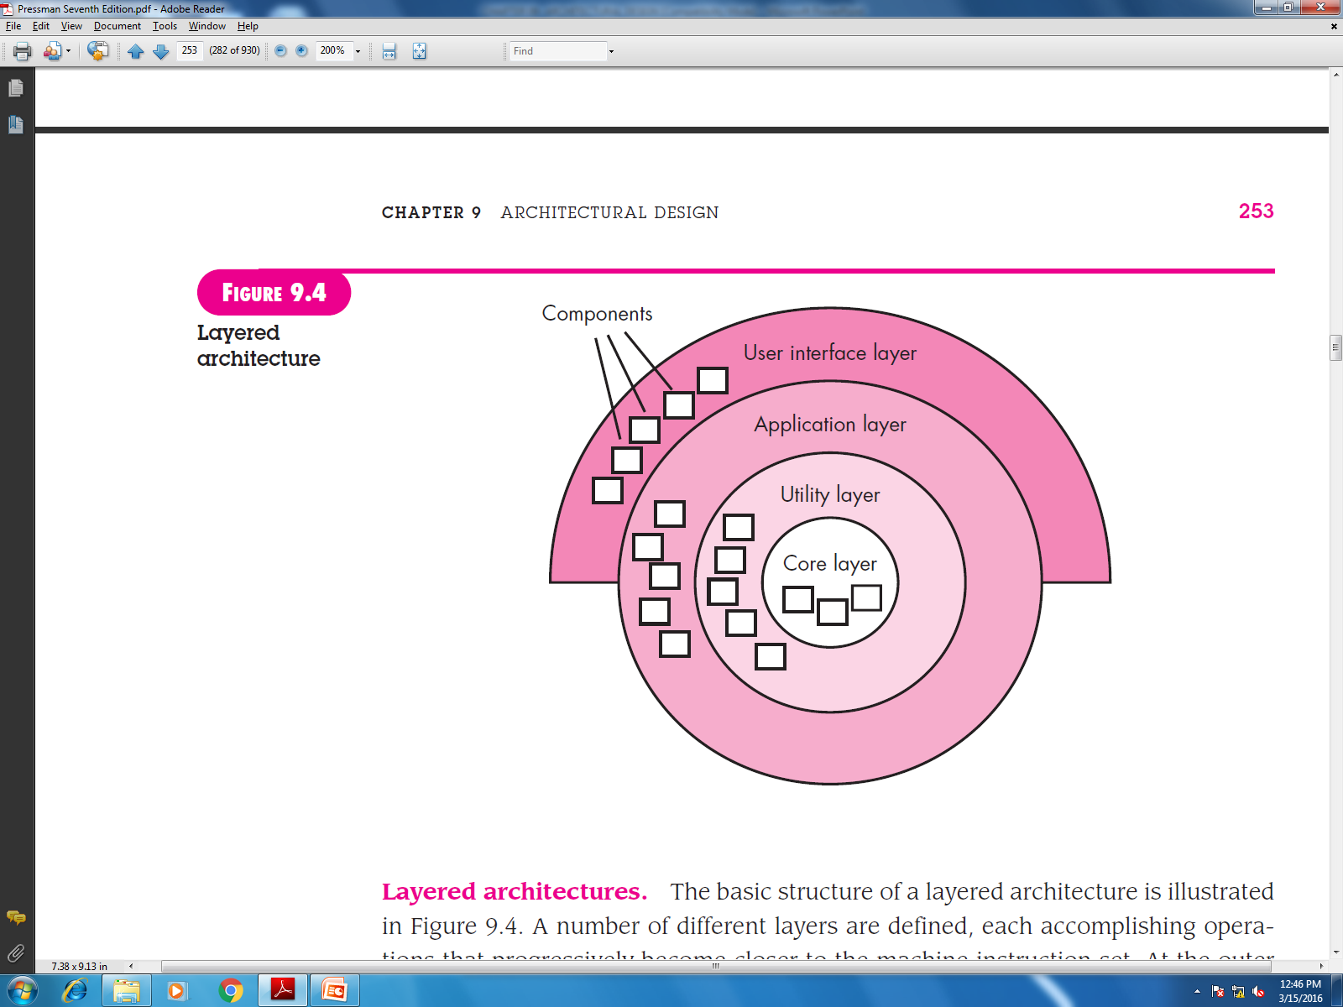
Layered Architecture

Slide 13
Architectural Patterns
Concurrency—applications must handle multiple tasks in a manner that simulates parallelism
operating system process management pattern
task scheduler pattern

Slide 14
Architectural Patterns (Cont.)
Persistence—Data persists if it survives past the execution of the process that created it. Two patterns are common:
a database management system pattern that applies the storage and retrieval capability of a DBMS to the application architecture
an application level persistence pattern that builds persistence features into the application architecture

Slide 15
Architectural Patterns (cont.)
Distribution— the manner in which systems or components within systems communicate with one another in a distributed environment
A broker acts as a ‘middle-man’ between the client component and a server component.

Slide 16
Architectural Design
The software must be placed into context
The design should define the external entities (other systems, devices, people) that the software interacts with and the nature of the interaction
A set of architectural archetypes should be identified
An archetype is an abstraction (similar to a class) that represents one element of system behavior
The designer specifies the structure of the system by defining and refining software components that implement each archetype

Slide 17
Architectural Context

Slide 18
Archetypes
UML relationships
for
SafeHome
security
function
archetypes

Slide 19
Component Structure

Slide 20
Refined Component Structure

Slide 21
Architectural Complexity
The overall complexity of a proposed architecture is assessed by considering the dependencies between components within the architecture.
Sharing dependencies represent dependence relationships among consumers who use the same resource or producers who produce for the same consumers.
Flow dependencies represent dependence relationships between producers and consumers of resources.
Constrained dependencies represent constraints on the relative flow of control among a set of activities.

Slide 22
ADL
Architectural description language (ADL) provides a semantics and syntax for describing a software architecture
Provide the designer with the ability to:
decompose architectural components
compose individual components into larger architectural blocks and
represent interfaces (connection mechanisms) between components.

Slide 23
An Architectural Design Method
customer requirements
"four bedrooms, three baths,
lots of glass ..."
architectural design

Slide 24
Deriving Program Architecture
Program
Architecture

Slide 25
Partitioning the Architecture
“Horizontal” and “vertical” partitioning are required

Slide 26
Horizontal Partitioning
Define separate branches of the module hierarchy for each major function
Use control modules to coordinate communication between functions
function 1
function 3
function 2

Slide 27
Vertical Partitioning: Factoring
Design so that decision making and work are stratified
Decision making modules should reside at the top of the architecture
Decision-makers
Workers

Slide 28
Why Partitioned Architecture?
Results in software that is easier to test
Leads to software that is easier to maintain
Results in propagation of fewer side effects
Results in software that is easier to extend

Slide 29

Design concept
Design Concepts, Design Model, Software Architecture, Data Design, Architectural Styles and Patterns, Architectural Design, Alternative architectural designs, Modeling Component level design and its modeling, Procedural Design, Object Oriented Design.
Image source : Google

Slide 30
Software Design
Mitch Kapor, the creator of Lotus 1-2-3, presented a “software design manifesto” in Dr. Dobbs Journal. He said:
Good software design should exhibit:
Firmness: A program should not have any bugs that inhibit its function.
Commodity: A program should be suitable for the purposes for which it was intended.
Delight: The experience of using the program should be pleasurable one.

Slide 31
Analysis Model -> Design Model
Image source : Google

Slide 32
Design and Quality
• The design must implement all of the explicit requirements contained in the analysis model, and it must accommodate all of the implicit requirements desired by the customer.
The design must be a readable, understandable guide for those who generate code and for those who test and subsequently support the software.
The design should provide a complete picture of the software, addressing the data, functional, and behavioral domains from an implementation perspective.

Slide 33
Fundamental Concepts
Abstraction—data, procedure, control
Architecture—the overall structure of the software
Patterns—”conveys the essence” of a proven design solution
Separation of concerns—any complex problem can be more easily handled if it is subdivided into pieces
Modularity—compartmentalization of data and function
Hiding—controlled interfaces
Functional independence—single-minded function and low coupling

Slide 34
Fundamental Concepts (Cont.)
Refinement—elaboration of detail for all abstractions
Aspects—a mechanism for understanding how global requirements affect design
Refactoring—a reorganization technique that simplifies the design
OO design concepts
Design Classes—provide design detail that will enable analysis classes to be implemented

Slide 35
Data Abstraction
door
manufacturer
model number
type
swing direction
inserts
lights
type
number
weight
opening mechanism
implemented as a data structure

Slide 36
Procedural Abstraction
open
details of enter
algorithm
implemented with a "knowledge" of the
object that is associated with enter

Slide 37
Patterns
Design Pattern Template
Pattern name—describes the essence of the pattern in a short but expressive name
Intent—describes the pattern and what it does
Also-known-as—lists any synonyms for the pattern
Motivation—provides an example of the problem
Applicability—notes specific design situations in which the pattern is applicable
Structure—describes the classes that are required to implement the pattern

Slide 38
Modularity
"Modularity is the single attribute of software that allows a program to be intellectually manageable" [mye78].
Monolithic software (i.e., A large program composed of a single module) cannot be easily grasped by a software engineer.

Slide 39
Modularity (Cont.)
The number of control paths, span of reference, number of variables, and overall complexity would make understanding close to impossible.
In almost all instances, you should break the design into many modules, hoping to make understanding easier and as a consequence, reduce the cost required to build the software.

Slide 40
Modularity: Trade-offs
What is the "right" number of modules
for a specific software design?
module development cost
cost of
software
module
integration
cost
optimal number
number of modules
of modules

Slide 41
Information Hiding
module
• algorithm
controlled
interface
• data structure
• details of external interface
• resource allocation policy
clients
"secret"
a specific design decision

Slide 42
Why Information Hiding?
Reduces the likelihood of “side effects”
Limits the global impact of local design decisions
Emphasizes communication through controlled interfaces
Discourages the use of global data
Leads to encapsulation—an attribute of high quality design
Results in higher quality software

Slide 43
Stepwise Refinement
open
walk to door;
reach for knob;
open door;
repeat until door opens
turn knob clockwise;
walk through;
if knob doesn't turn, then
close door.
take key out;
find correct key;
insert in lock;
endif
pull/push door
move out of way;
end repeat

Slide 44
Sizing Modules: Two Views

Slide 45
Functional Independence
Functional independence is achieved by developing modules with "single-minded" function and an "aversion" to excessive interaction with other modules.

Slide 46
Functional Independence (Cont.)
Cohesion is an indication of the relative functional strength of a module.
A cohesive module performs a single task, requiring little interaction with other components in other parts of a program. Stated simply, a cohesive module should (ideally) do just one thing.
Coupling is an indication of the relative interdependence among modules.
Coupling depends on the interface complexity between modules, the point at which entry or reference is made to a module, and what data pass across the interface.

Slide 47
Refactoring
Fowler [FOW99] defines refactoring in the following manner:
"refactoring is the process of changing a software system in such a way that it does not alter the external behavior of the code [design] yet improves its internal structure.”

Slide 48
OO Design Concepts
Design classes
Entity classes
Boundary classes
Controller classes
Inheritance—all responsibilities of a superclass is immediately inherited by all subclasses
Messages—stimulate some behavior to occur in the receiving object
Polymorphism—a characteristic that greatly reduces the effort required to extend the design

Slide 49
Design Classes
Analysis classes are refined during design to become entity classes
Boundary classes are developed during design to create the interface (e.g., Interactive screen or printed reports) that the user sees and interacts with as the software is used.
Boundary classes are designed with the responsibility of managing the way entity objects are represented to users.

Slide 50
Design Classes (Cont.)
Controller classes are designed to manage
The creation or update of entity objects;
the instantiation of boundary objects as they obtain information from entity objects;
complex communication between sets of objects;
validation of data communicated between objects or between the user and the application.

Slide 51
The Design Model

Slide 52
Design Model Elements

Slide 53
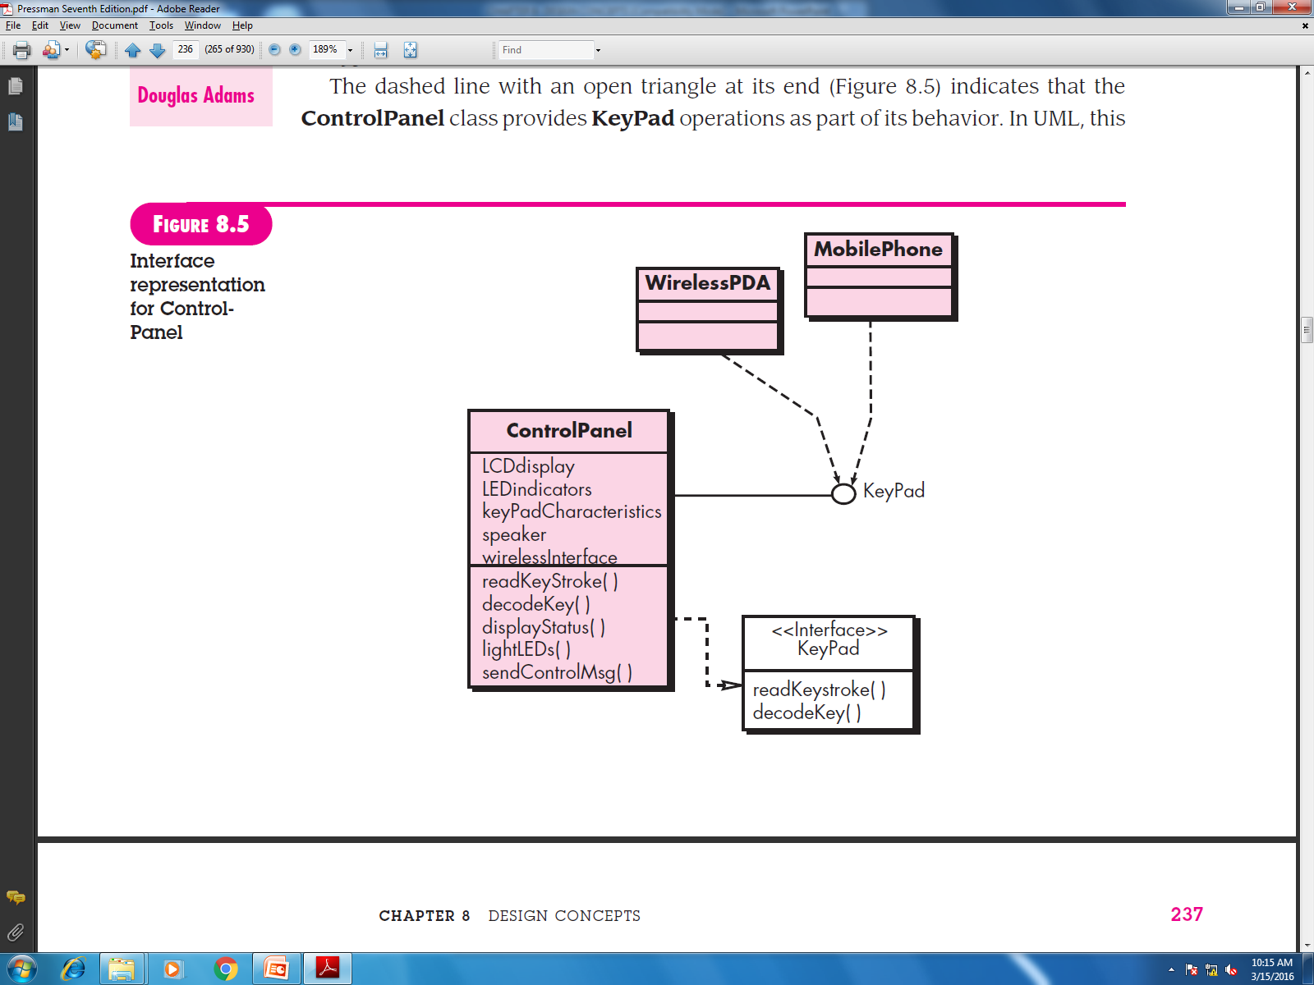
Interface Elements

Slide 54
Component-Level Design Elements
The component-level design for software is the equivalent to a set of detailed drawings (and specifications) for each room in a house.
The component-level design for software fully describes the internal detail of each software component.
To accomplish this, the component-level design defines data structures for all local data objects and algorithmic detail for all processing.

Slide 55
Component Elements

Slide 56
Deployment Elements
Deployment-level design elements indicate how software functionality and subsystems will be allocated within the physical computing environment that will support the software.

Slide 57
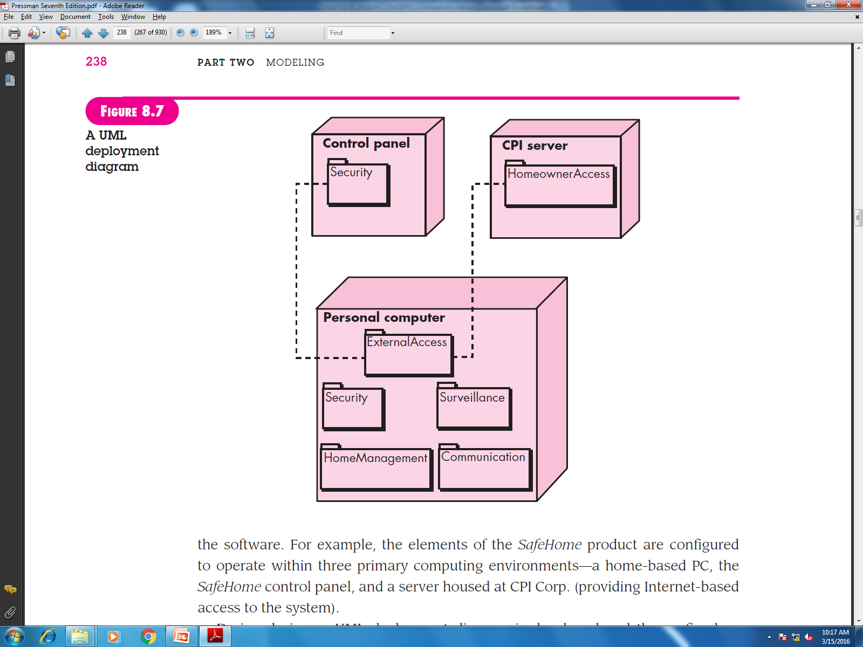
Deployment Elements (Cont.)

Slide 58
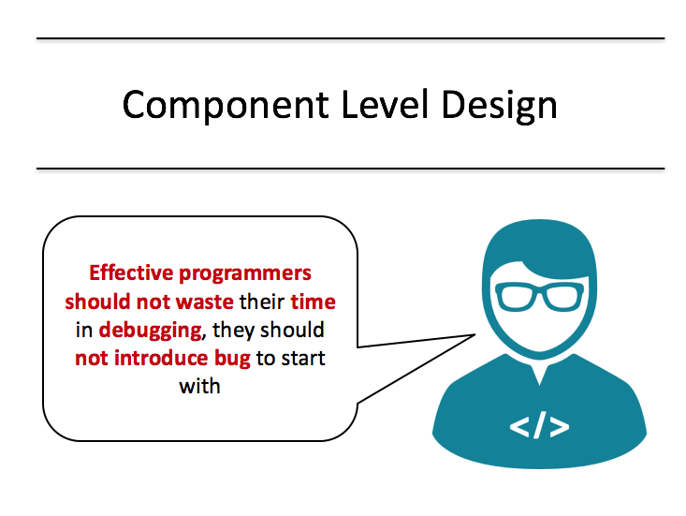
Architectural Design
Image source : Google

Slide 59
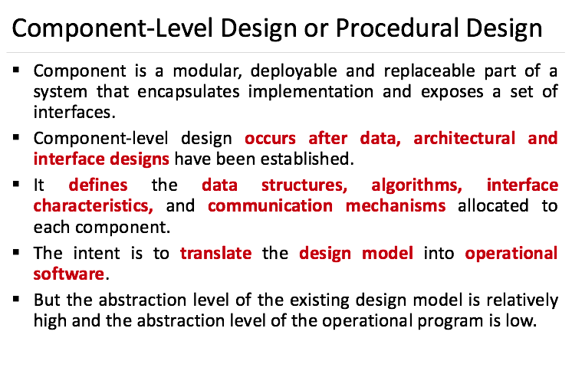

Slide 60
Design Guidelines
Components
Naming conventions should be established for components that are specified as part of the architectural model and then refined and elaborated as part of the component-level model
Interfaces
Interfaces provide important information about communication and collaboration (as well as helping us to achieve the OPC)
Dependencies and inheritance
It is a good idea to model dependencies from left to right and inheritance from bottom (derived classes) to top (base classes).

Slide 61
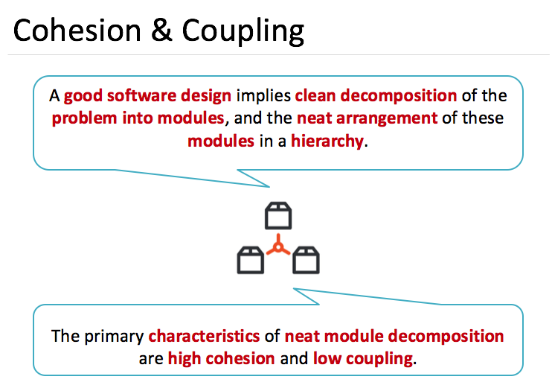

Slide 62
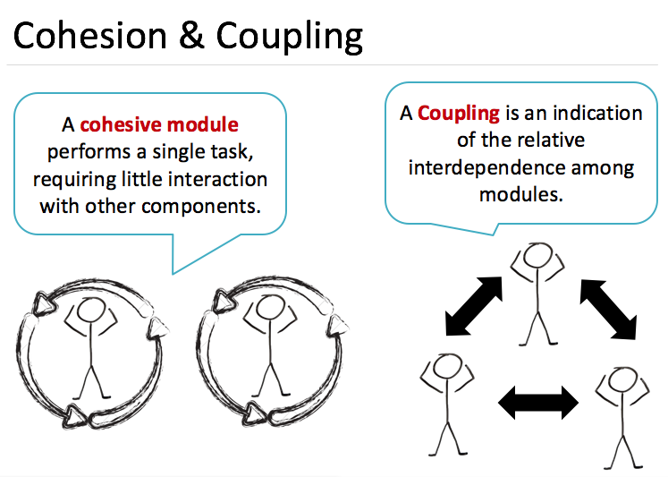

Slide 63
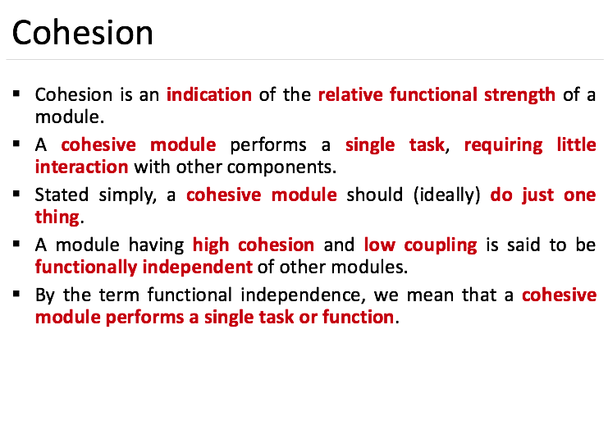

Slide 64
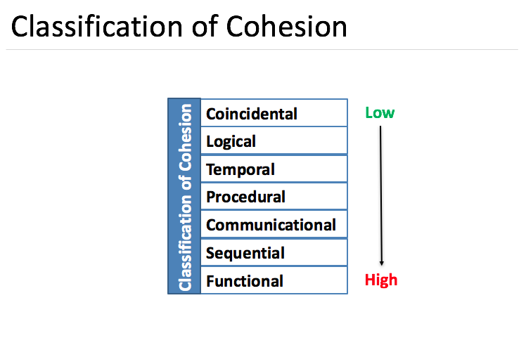

Slide 65
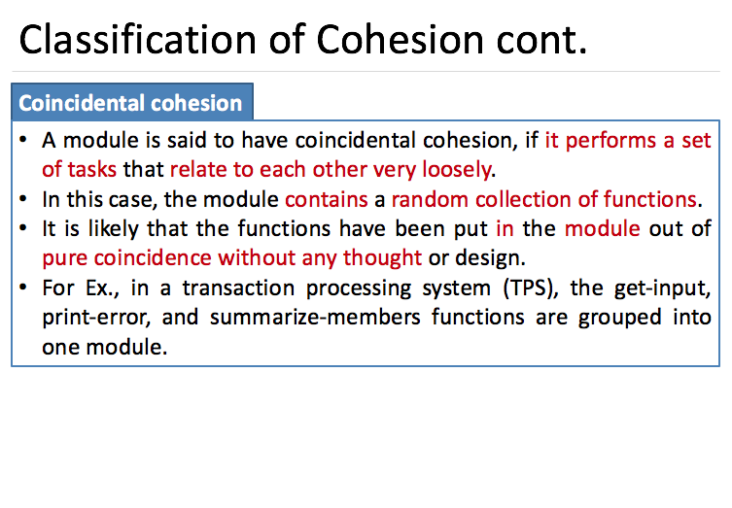

Slide 66
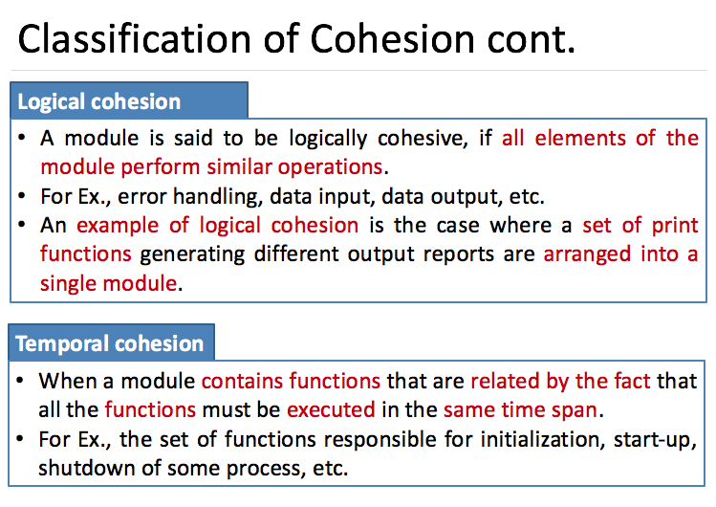

Slide 67
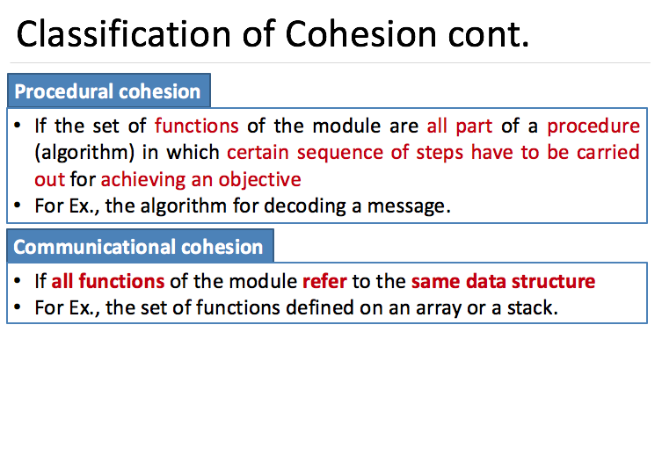

Slide 68
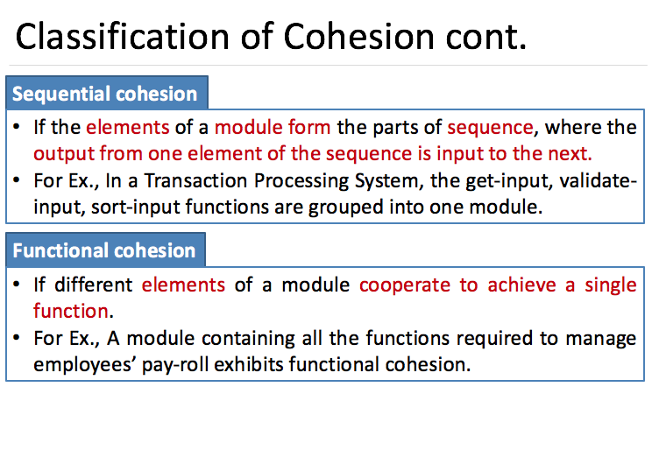

Slide 69
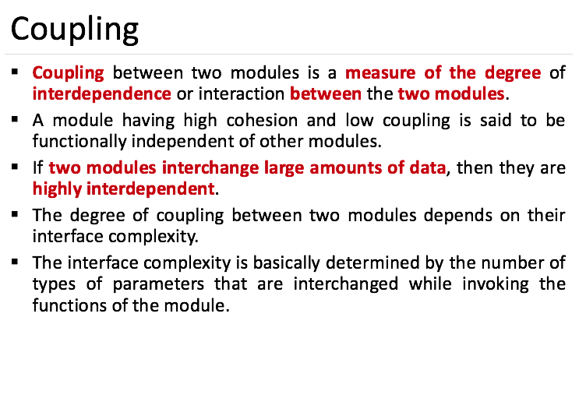

Slide 70
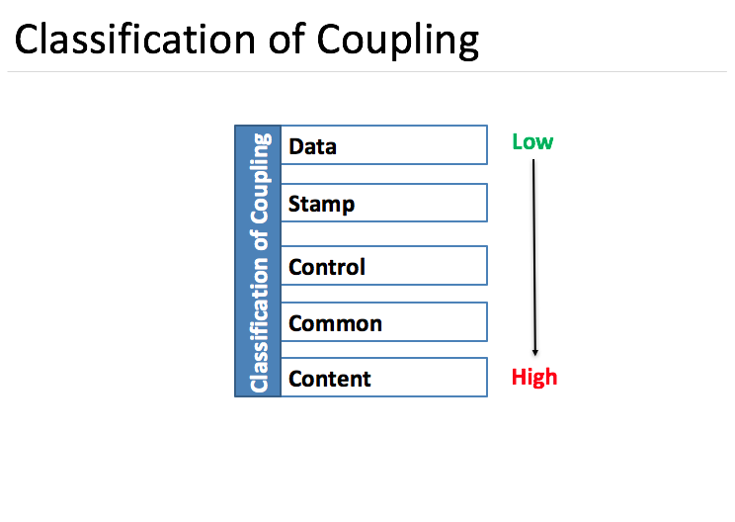

Slide 71
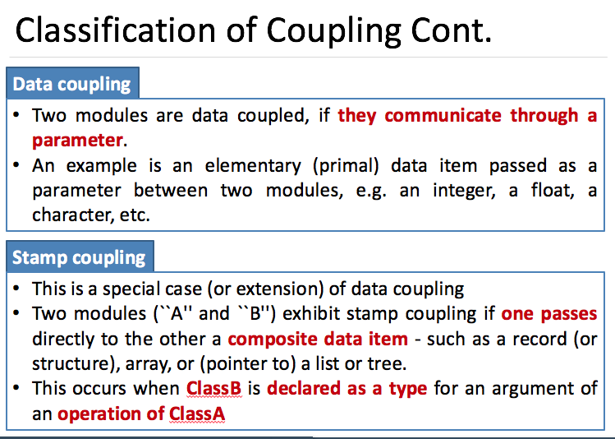

Slide 72
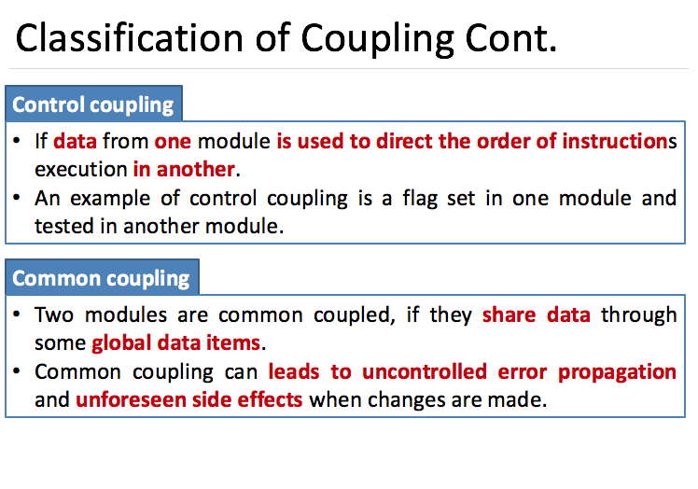

Slide 73
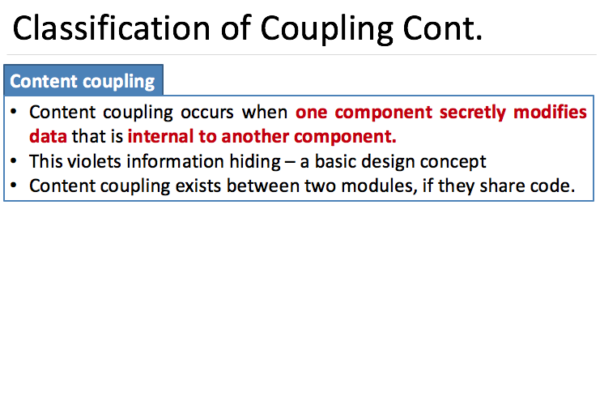

Slide 74
Algorithm Design
The closest design activity to coding
The approach:
Review the design description for the component
Use stepwise refinement to develop algorithm
Use structured programming to implement procedural logic
Use ‘formal methods’ to prove logic

Slide 75
Stepwise Refinement
open
walk to door;
reach for knob;
open door;
repeat until door opens
turn knob clockwise;
walk through;
if knob doesn't turn, then
close door.
take key out;
find correct key;
insert in lock;
endif
pull/push door
move out of way;
end repeat

Slide 76
CBSE Activities
Component qualification
Component adaptation
Component composition
Component update

Slide 77
Classifying and Retrieving Components
Enumerated classification—components are described by defining a hierarchical structure in which classes and varying levels of subclasses of software components are defined
Faceted classification—a domain area is analyzed and a set of basic descriptive features are identified
Attribute-value classification—a set of attributes are defined for all components in a domain area

Slide 78
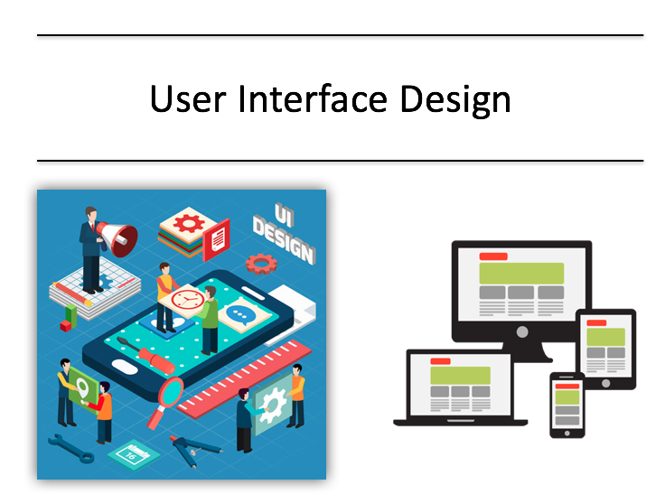
UI Design
Image source : Google

Slide 79
Interface Design
Easy to learn?
Easy to use?
Easy to understand?

Slide 80
Interface Design
Typical Design Errors
lack of consistency
too much memorization
no guidance / help
no context sensitivity
poor response
Arcane/unfriendly

Slide 81
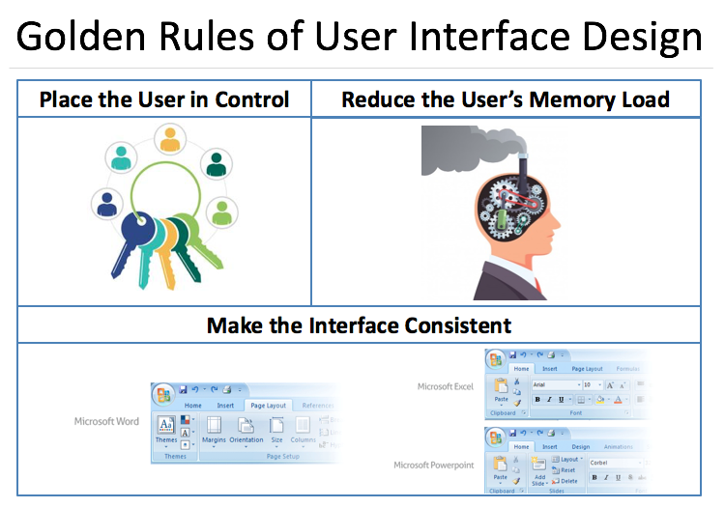

Slide 82
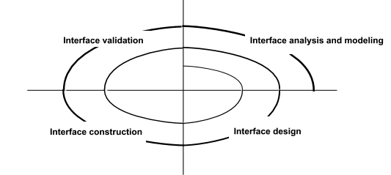
User Interface Design Process

Slide 83
Interface Analysis
Interface analysis means understanding
(1) the people (end-users) who will interact with the system through the interface;
(2) the tasks that end-users must perform to do their work,
(3) the content that is presented as part of the interface
(4) the environment in which these tasks will be conducted.

Slide 84
Task Analysis and Modeling
The goal of task analysis is to answer the following questions:
What work will the user perform in specific circumstances?
What tasks and subtasks will be performed as the user does the work?
What specific problem domain objects will the user manipulate as work is performed?
What is the sequence of work tasks—the workflow?
What is the hierarchy of tasks?

Slide 85
Task Analysis and Modeling (Cont.)
To answer these questions, many techniques are discussed, but in this instance, these techniques are applied to the user interface.
Use-cases define basic interaction
Task elaboration refines interactive tasks
Object elaboration identifies interface objects (classes)
Workflow analysis defines how a work process is completed when several people (and roles) are involved

Slide 86
User Interface Design Patterns: Design Issues
Response time
Help facilities
Error handling
Menu and command labeling
Application accessibility

Slide 87
Mapping User Objectives

Slide 88
Aesthetic Design
Don’t be afraid of white space.
Emphasize content.
Organize layout elements from top-left to bottom right.
Group navigation, content, and function geographically within the page.
Don’t extend your real estate with the scrolling bar.
Consider resolution and browser window size when designing layout.

Slide 89

Data Oriented Analysis & Design
Difference between Data and Information, E-R Diagram, Dataflow Model, Control Flow Model, Control and Process Specification, Data Dictionary
Image source : Google

Slide 90
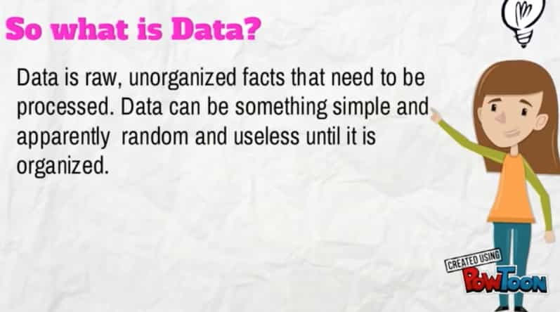
Data

Slide 91
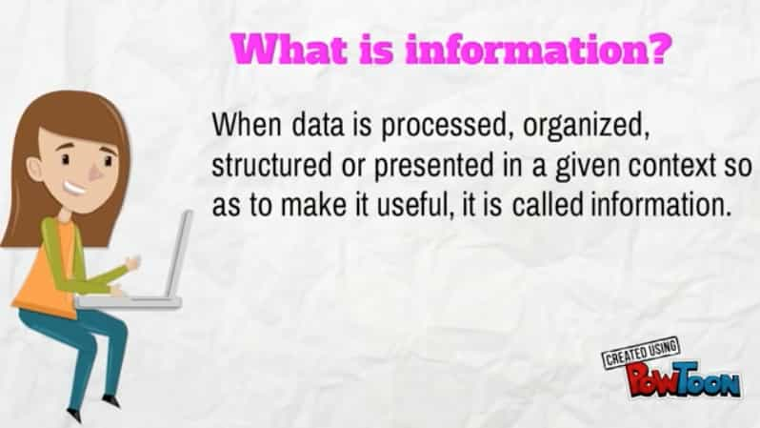
Information

Slide 92
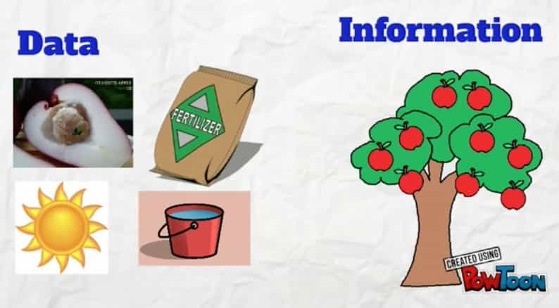
Data & Information

Slide 93
E-R Model
It is the most conceptual model used for designing a database.
Proposed by Dr. Peter Chen in 1960
E-R model views the real world as a set of basic objects (entities) , their characteristics (attributes) and associations among objects (relationship).
Entities , Attributes & relationship are the basic concept of an E-R model.

Slide 94
Entity
An entity is an object that exists and is distinguishable from other objects.
Example: specific person, company, event, plant
Entities have attributes
Example: people have names and addresses
An entity set is a set of entities of the same type that share the same properties.
Example: set of all persons, companies, trees, holidays

Slide 95
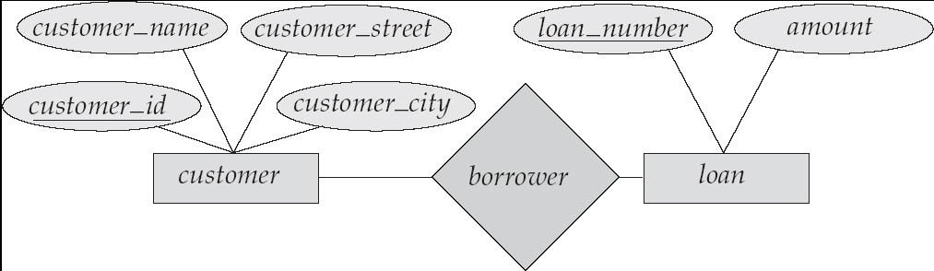
E-R Diagrams
Rectangles represent entity sets.
Diamonds represent relationship sets.
Lines link attributes to entity sets and entity sets to relationship sets.
Ellipses represent attributes
Double ellipses represent multivalued attributes.

Slide 96
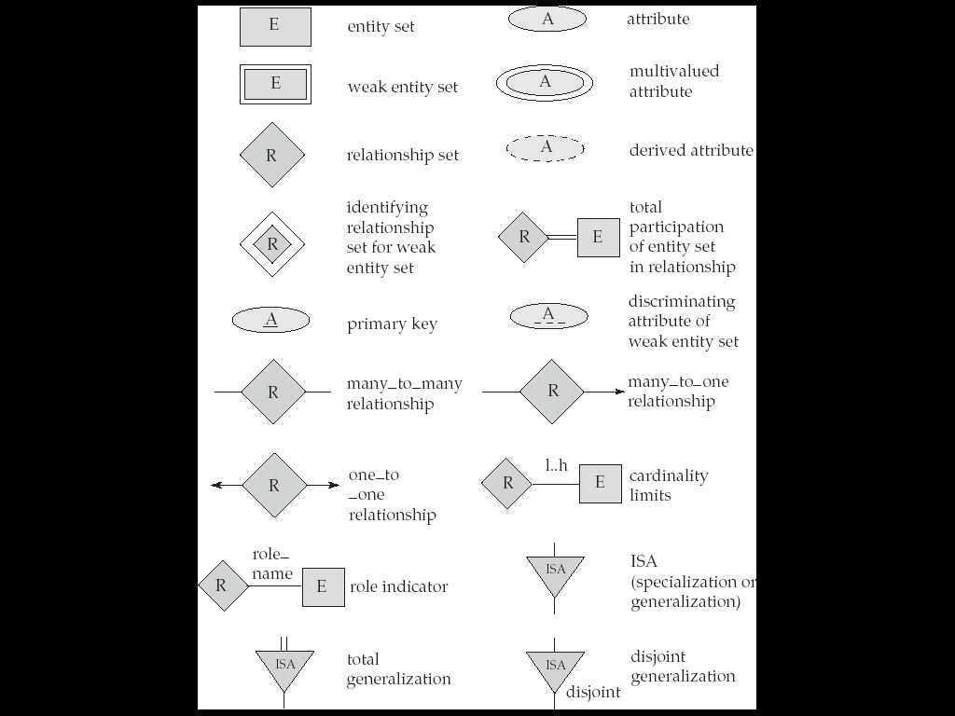
E-R Diagram Notations

Slide 97
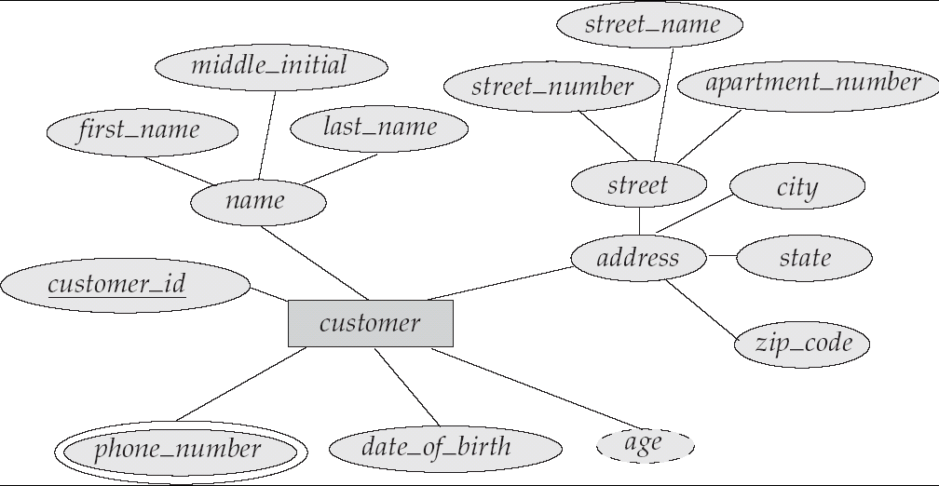
E-R Diagram With Composite, Multivalued, and Derived Attributes

Slide 98
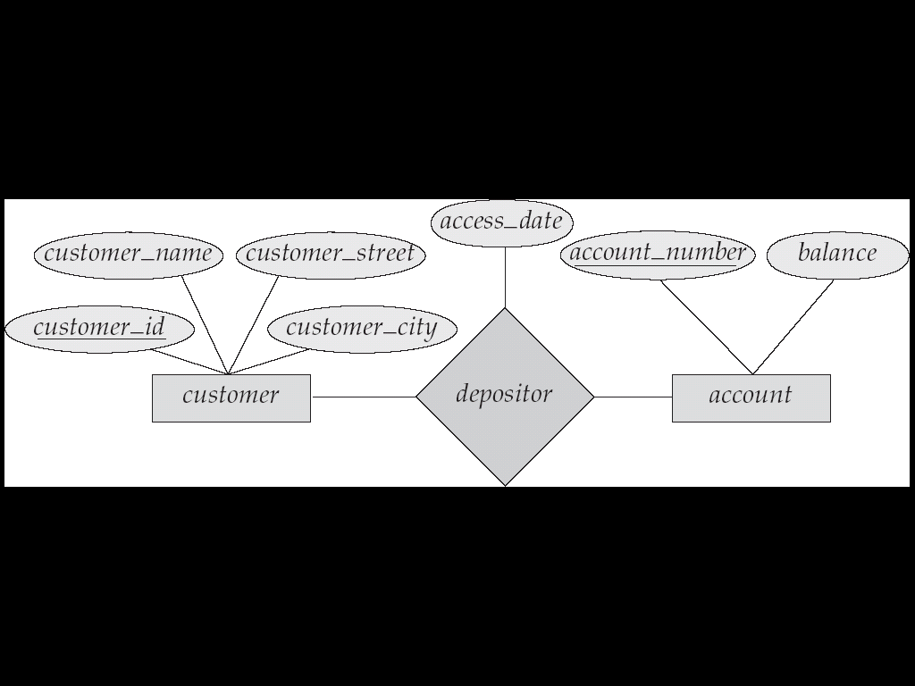
Relationship Sets with Attributes

Slide 99
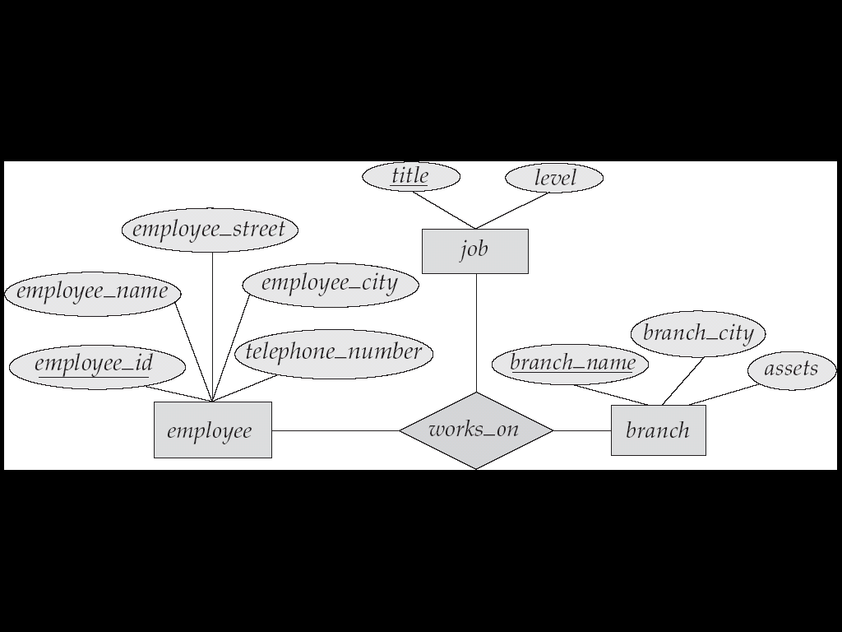
E-R Diagram with a Ternary Relationship

Slide 100
Cardinality Constraints
We express cardinality constraints by drawing either a directed line (→), signifying “one,” or an undirected line (—), signifying “many,” between the relationship set and the entity set.
One-to-one relationship:
A customer is associated with at most one loan via the relationship borrower
A loan is associated with at most one customer via borrower

Slide 101
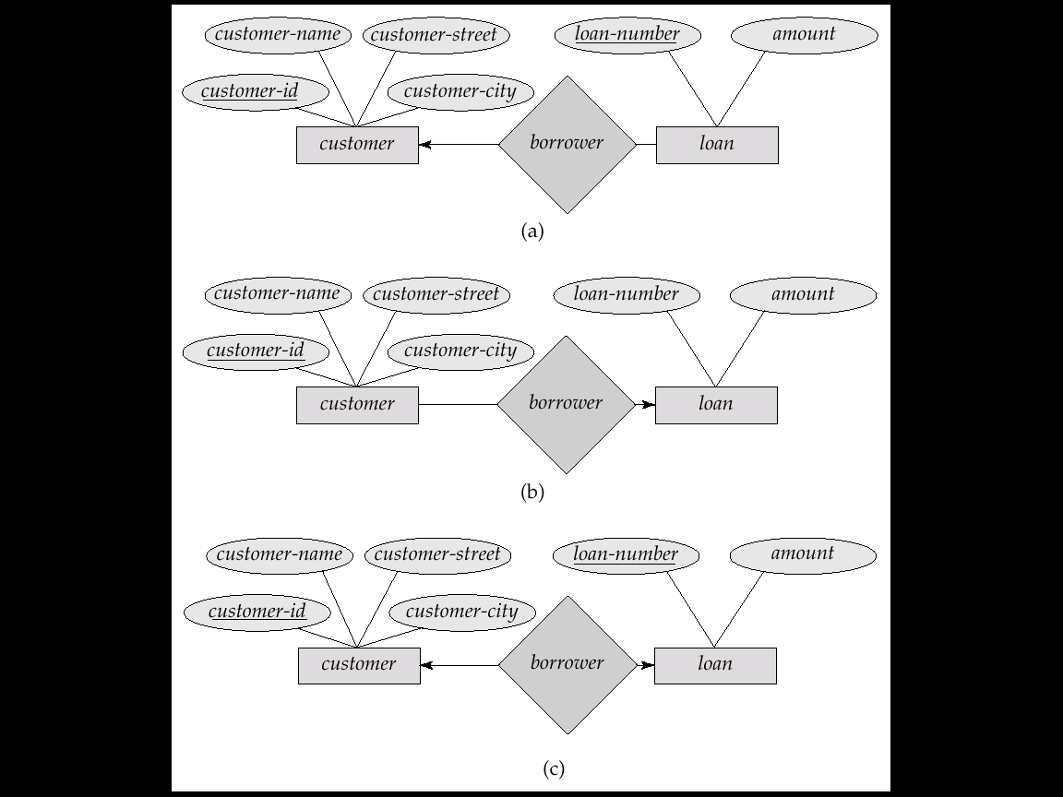
One-To-Many Relationship
In the one-to-many relationship a loan is associated with at most one customer via borrower, a customer is associated with several (including 0) loans via borrower

Slide 102
Many-To-One Relationships
In a many-to-one relationship a loan is associated with several (including 0) customers via borrower, a customer is associated with at most one loan via borrower

Slide 103
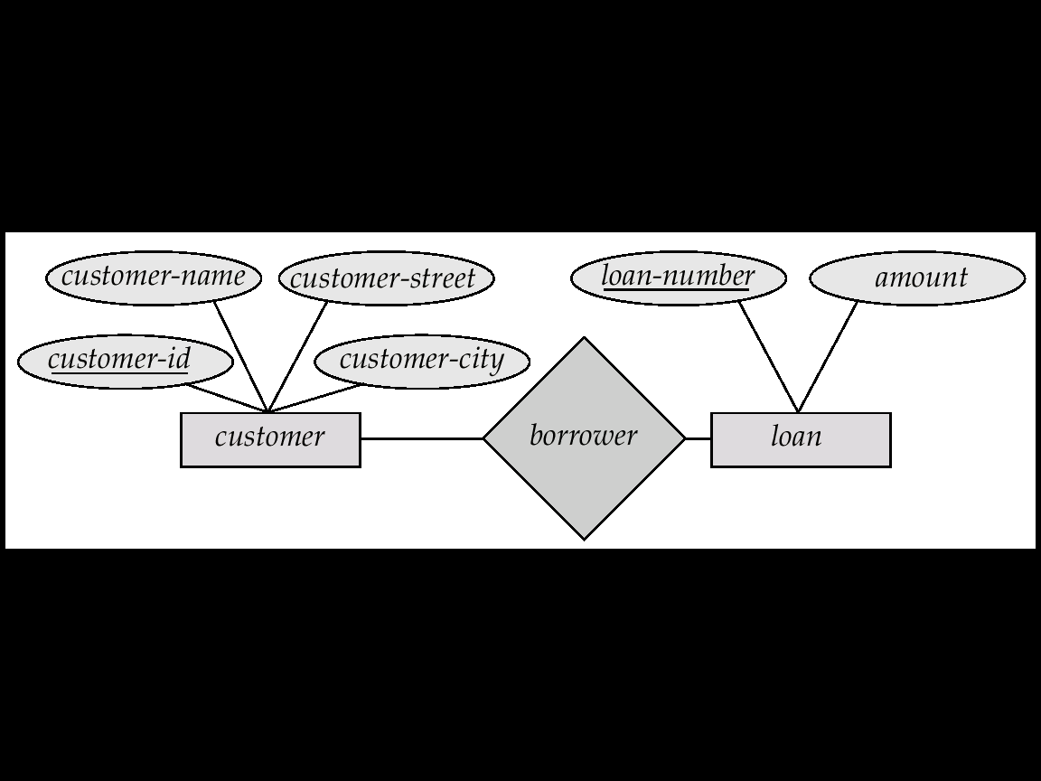
Many-To-Many Relationship
A customer is associated with several (possibly 0) loans via borrower
A loan is associated with several (possibly 0) customers via borrower

Slide 104
E-R Diagram with a Ternary Relationship

Slide 105
Cont...
Extended E-R features
Specialization
Generalization
Aggregation

Slide 106
Specialization
Top-down design process; we designate subgroupings within an entity set that are distinctive from other entities in the set.
These subgroupings become lower-level entity sets that have attributes or participate in relationships that do not apply to the higher-level entity set.
Ex. Entity type BOOK can be further classified into three types. TEXTBOOK, LANGUAGE_BOOK and NOVEL.
Local or Specific Attribute- some additional set of that differentiate them from each other.
TEXTBOOK may have additional attribute Subject( computer , maths , science ctc

Slide 107
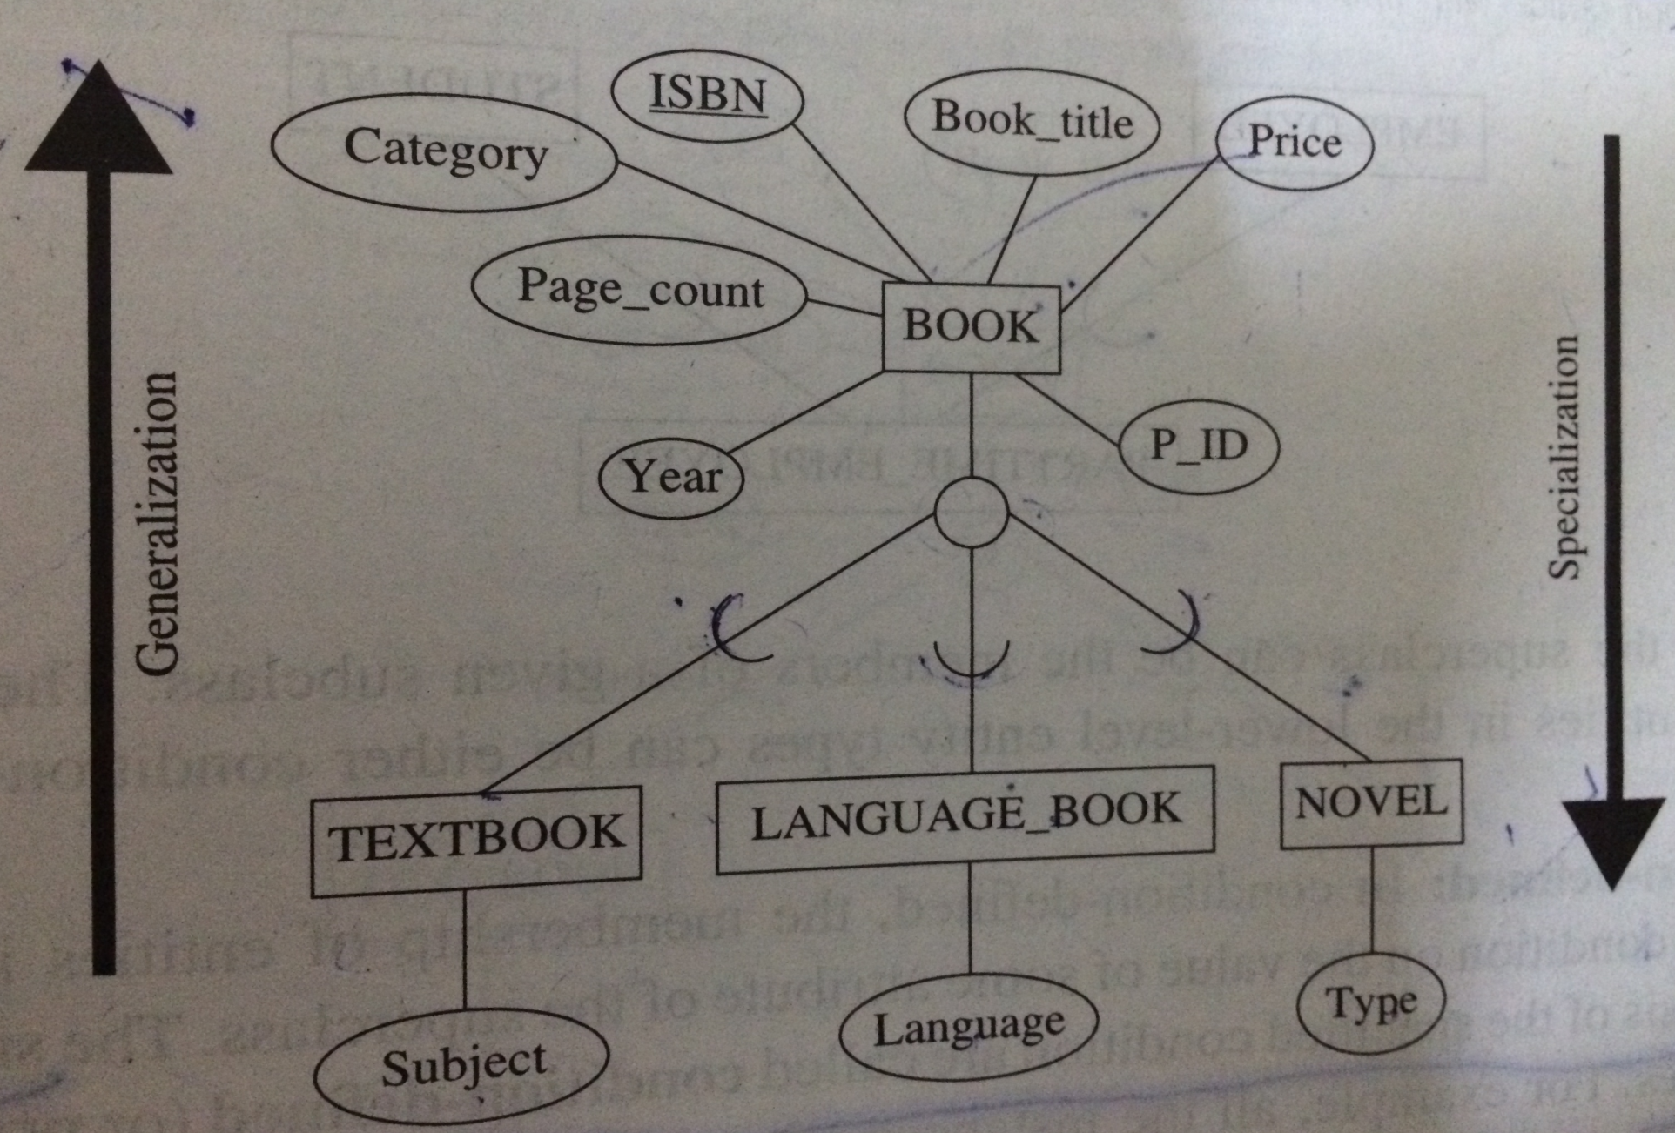
Cont....

Slide 108
Generalization
A bottom-up design process – combine a number of entity sets that share the same features into a higher-level entity set.
DBD may first identify entity type TEXTBOOK, LANG_BOOK, NOVEL then combine the common attribute to form BOOK.
Specialization and generalization are simple inversions of each other; they are represented in an E-R diagram in the same way.
The terms specialization and generalization are used interchangeably

Slide 109

Cont....

Slide 110
Flow Modeling Notation
external entity
process
data flow
data store

Slide 111
External Entity
A producer or consumer of data
Examples: a person, a device, a sensor
Another example: computer-based
system
Data must always originate somewhere
and must always be sent to something

Slide 112
Process
A data transformer (changes input
to output)
Examples: compute taxes, determine area,
format report, display graph
Data must always be processed in some
way to achieve system function

Slide 113
Data Flow
Data flows through a system, beginning
as input and transformed into output.
base
compute
triangle
area
area
height

Slide 114
Data Stores
Data is often stored for later use.
sensor #
sensor #, type,
location, age
look-up
sensor
data
report required
type,
location, age
sensor number
sensor data

Slide 115
Data Flow Diagramming: Guidelines
All icons must be labeled with meaningful names
The DFD evolves through a number of levels of detail
Always begin with a context level diagram (also called level 0)
Always show external entities at level 0
Always label data flow arrows
Do not represent procedural logic

Slide 116
Constructing a DFD—I
Review user scenarios and/or the data model to isolate data objects and use a grammatical parse to determine “operations”
Determine external entities (producers and consumers of data)
Create a level 0 DFD

Slide 117
Level 0 DFD Example
Processing
request
User
Requested
video
signal
Digital
video
processor
Monitor
Video
source
NTSC
video signal

Slide 118
Constructing a DFD—II
Write a narrative describing the transform
Parse to determine next level transforms
“Balance” the flow to maintain data flow continuity
Develop a level 1 DFD
Use a 1:5 (approx.) Expansion ratio

Slide 119
The Data Flow Hierarchy
a
b
x
P
y
level 0
a
c
p2
f
p1
p4
b
d
5
p3
e
g
level 1

Slide 120
Data Dictionary
The data dictionary is a reference work of data about data (that is, metadata), one that is compiled by systems analysts to guide them through analysis and design.
Data flow diagrams are an excellent starting point for collecting data dictionary entries.

Slide 121
Data Dictionary (Cont.)
Data Dictionary may be used to also:
Validate the data flow diagram for completeness and accuracy.
Provide a stating point for developing screens and reports.
Determine the contents of data stored in files.
Develop the logic for data-flow diagram processes.

Slide 122
Data Dictionary Example
Table name: scheme1_master
Primary key: schemeid
Foreign key: null
References:

Slide 123
Data Dictionary Example
FIELDNAME | DATATYPE | SIZE | CONSTRAINT | DESCRIPTION
Schemeid | Varchar2 | 20 | Primary key | Stores the id of scheme
Time | Number | 10 |  | Stores the total time provided by scheme (in hours)
Days | Number | 10 |  | Stores the total days for expiring the scheme
Rupees | Number | 4 |  | Stores the amount for the schemes

Slide 124


www.paruluniversity.ac.in

